Slide 1
St. Louis Central Corridor West Building Permits
Monthly Report: August 2020

Slide 2
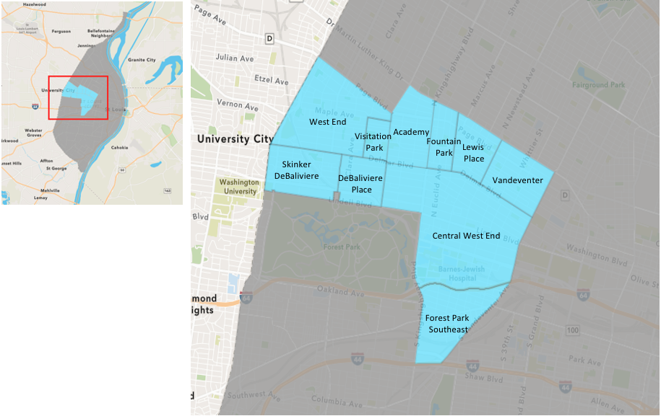
St. Louis Neighborhood Spatial Reference

Slide 3
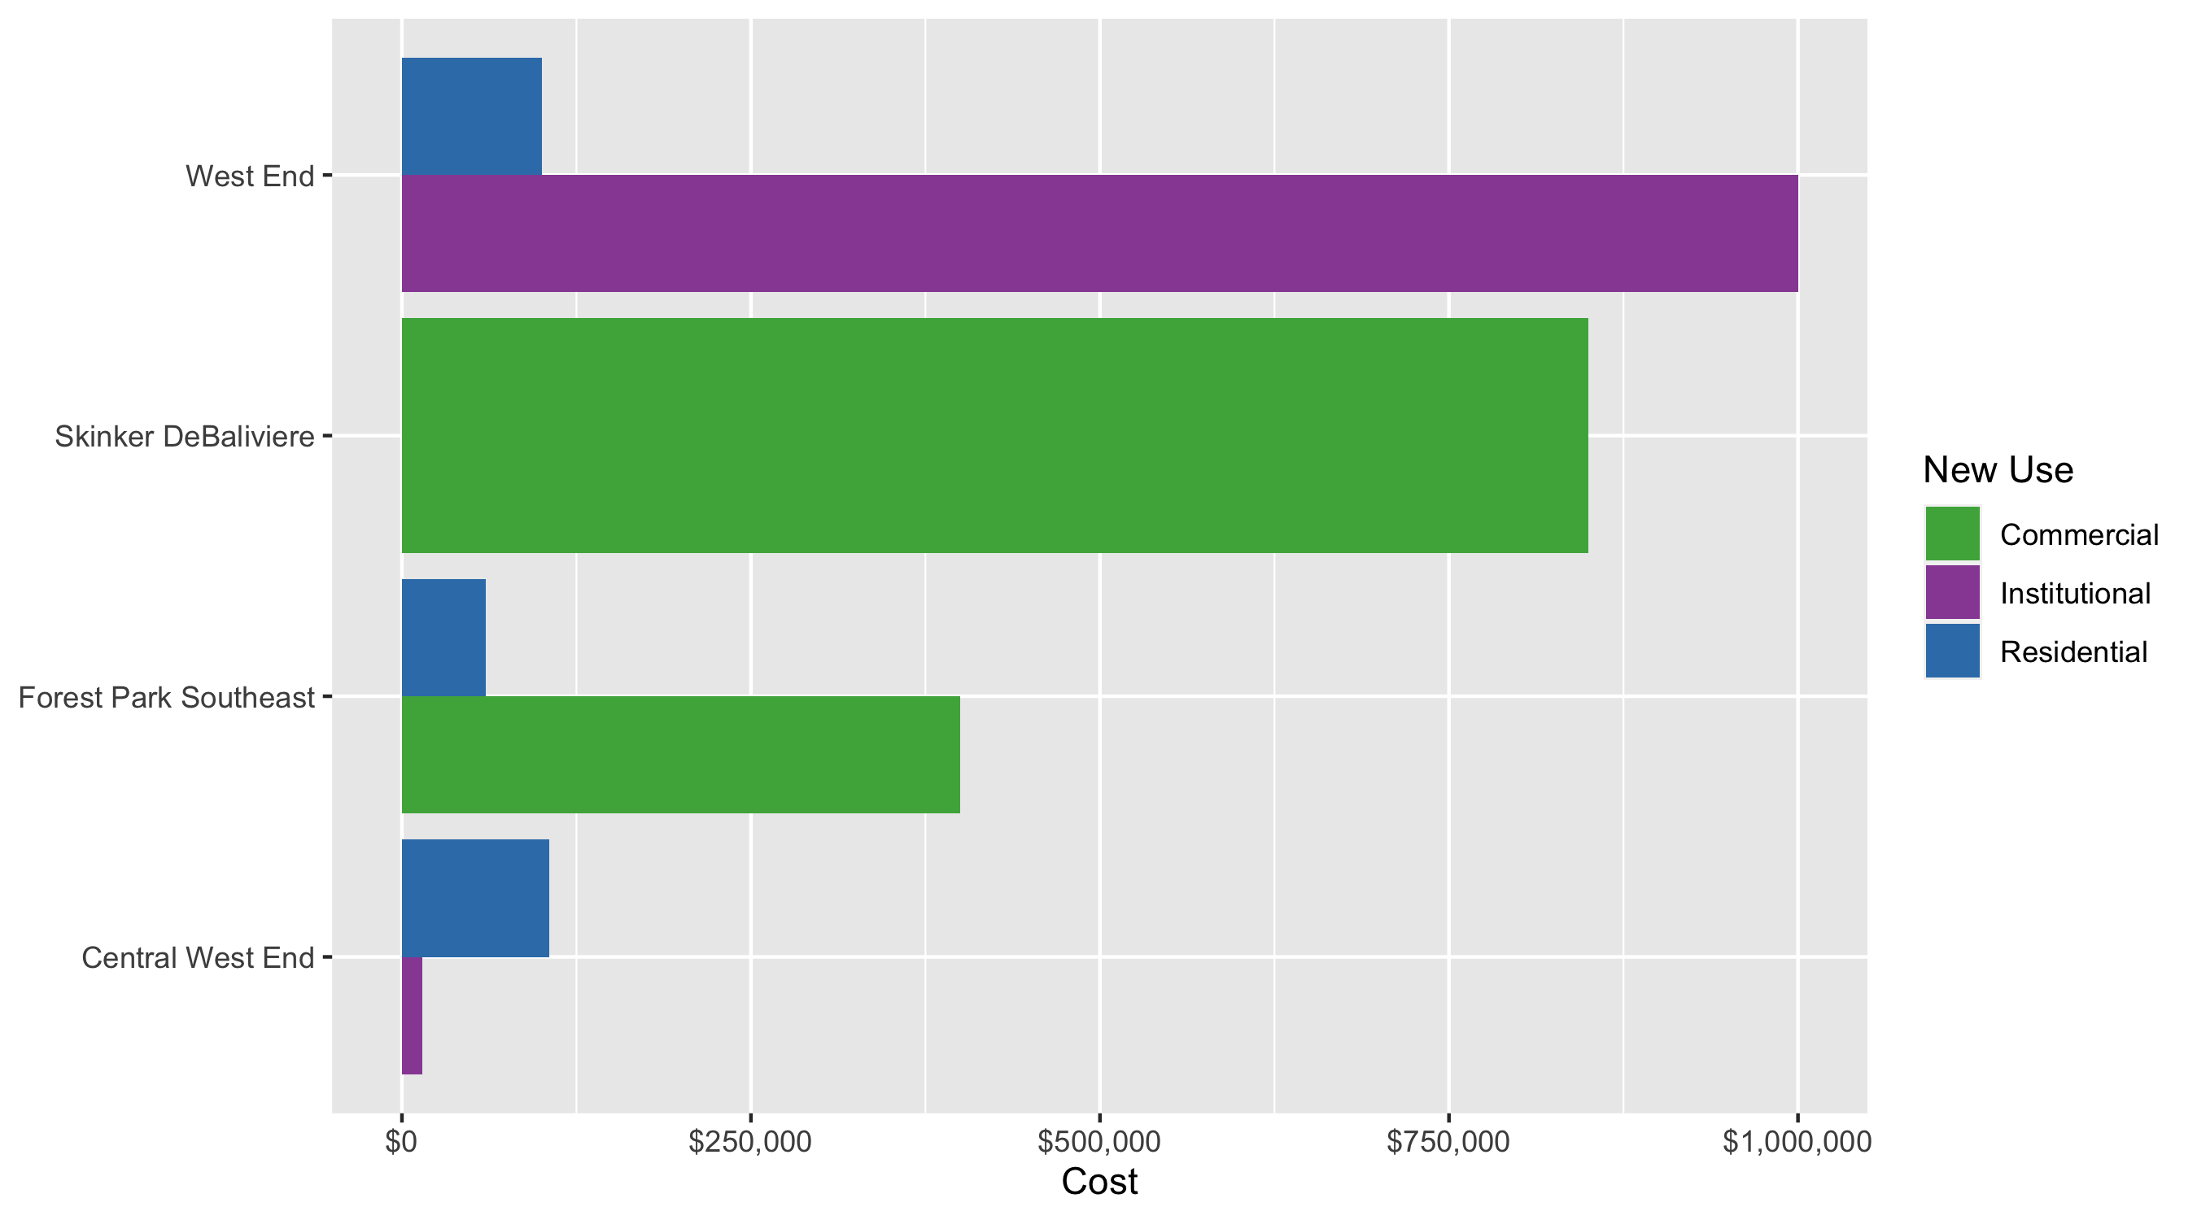
Neighborhood Summary: Average Building Permit Cost

Slide 4
Neighborhood Summary
August 2020 | August 2020 | August 2020 | August 2020
Neighborhood | Average Cost | # of Permits | Total Value of Permits
Academy | $0 | 0 | $0
Central West End | $53,585 | 7 | $375,093
DeBaliviere Place | $0 | 0 | $0
Forest Park Southeast | $230,000 | 2 | $460,000
Fountain Park | $0 | 0 | $0
Lewis Place | $0 | 0 | $0
Skinker DeBaliviere | $850,000 | 2 | $1,700,000
Vandeventer | $0 | 0 | $0
Visitation Park | $0 | 0 | $0
West End | $550,050 | 2 | $1,100,100
Last 6 Months | Last 6 Months | Last 6 Months | Last 6 Months
Neighborhood | Average Cost | # of Permits | Total Value of Permits
Academy | $29,974 | 19 | $569,500
Central West End | $421,119 | 191 | $80,433,697
DeBaliviere Place | $154,220 | 25 | $3,855,512
Forest Park Southeast | $115,295 | 54 | $6,225,939
Fountain Park | $58,357 | 7 | $408,500
Lewis Place | $86,740 | 5 | $433,700
Skinker DeBaliviere | $1,173,533 | 56 | $65,717,855
Vandeventer | $34,269 | 5 | $171,346
Visitation Park | $7,837 | 3 | $23,511
West End | $880,000 | 26 | $22,880,000

Slide 5
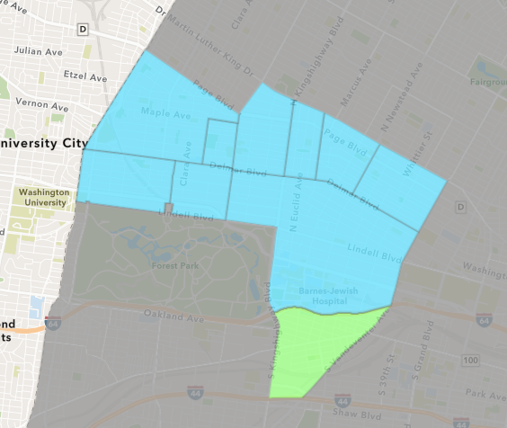
Forest Park Southeast
August 2020 Neighborhood Cost Breakdown
Mean: $230,000
Median: $230,000
Range: $60,000 - $400,000

Slide 6
Forest Park Southeast: Summary Notes
2 building permits in August 2020
-90.00% change compared to August 2019 (20 total building permits)
$230,000: Average building permit cost in August 2020
-52.48% change compared to August 2019 ($483,983)
69 total building permits in 2020
-42.02% change YTD compared to this time in 2019 (119 total building permits)
$103,786: YTD average building permit cost in 2020
-45.02% change YTD compared to this time in 2019 ($188,785)

Slide 7
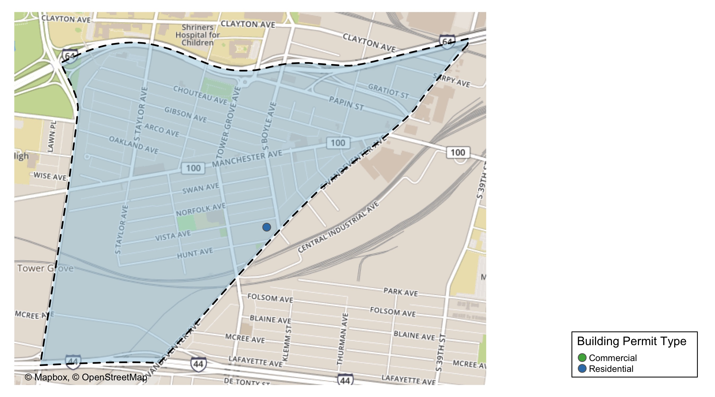
Forest Park Southeast

Slide 8
Neighborhood Summary
August 2020 | August 2020 | August 2020 | August 2020
Permit Use | Average Cost | # of Permits | Total Value of Permits
Commercial | $400,000 | 1 | $400,000
Industrial | $0 | 0 | $0
Institutional | $0 | 0 | $0
Residential | $60,000 | 1 | $60,000
Last 6 Months | Last 6 Months | Last 6 Months | Last 6 Months
Permit Use | Average Cost | # of Permits | Total Value of Permits
Commercial | $372,369 | 13 | $4,840,800
Industrial | $0 | 0 | $0
Institutional | $42,105 | 7 | $294,734
Residential | $32,071 | 34 | $1,090,405

Slide 9
Forest Park Southeast Individual Permit Breakdown
Owner | New Use | Cost | address
MCDERMOTT, BONNIE LOU | Residential | $60,000 | 4355 HUNT AV
4014 CHOUTEAU INVESTMENTS LLC C/O KO | Commercial | $400,000 | 4014 CHOUTEAU AV

Slide 10
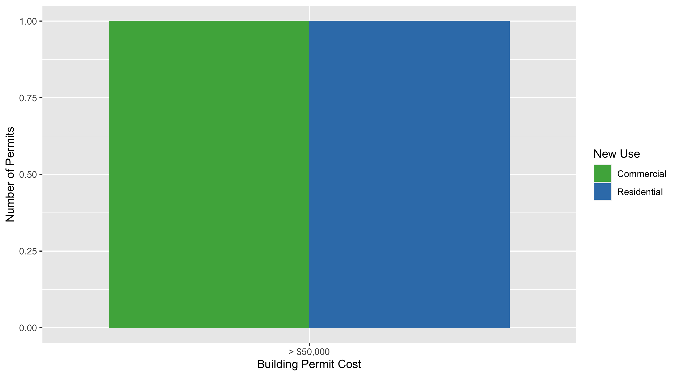
Forest Park Southeast Permit Cost Breakdown

Slide 11
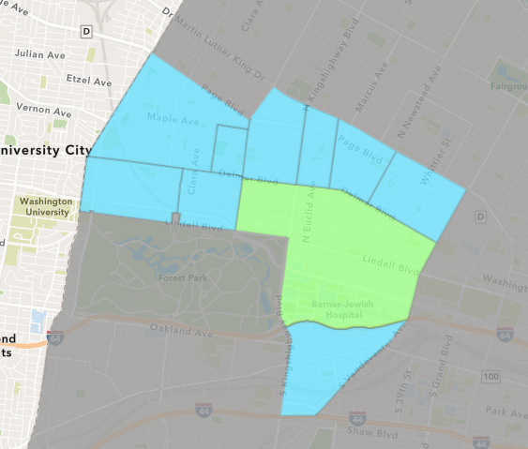
Central West End
August 2020 Neighborhood Cost Breakdown
Mean: $53,585
Median: $14,900
Range: $5,563 - $300,000

Slide 12
Central West End: Summary Notes
7 building permits in August 2020
-86.00% change compared to August 2019 (50 total building permits)
$53,585: Average building permit cost in August 2020
-67.85% change compared to August 2019 ($166,674)
258 total building permits in 2020
-16.77% change YTD compared to this time in 2019 (310 total building permits)
$447,620: YTD average building permit cost in 2020
79.40% change YTD compared to this time in 2019 ($249,507)

Slide 13
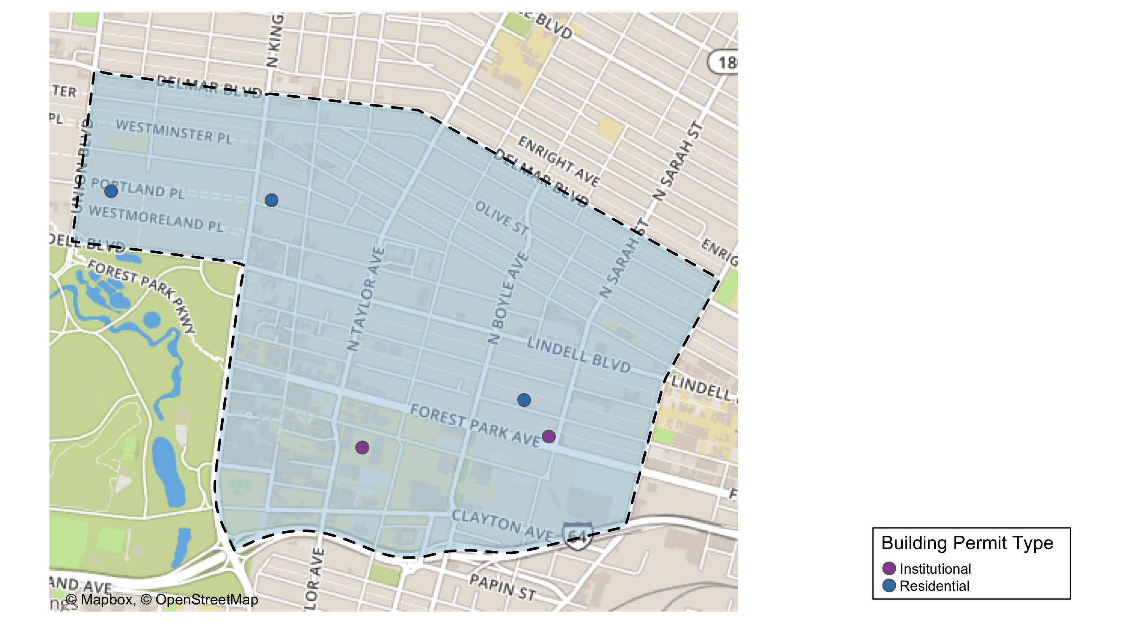
Central West End

Slide 14
Central West End
August 2020 | August 2020 | August 2020 | August 2020
Permit Use | Average Cost | # of Permits | Total Value of Permits
Commercial | $0 | 0 | $0
Industrial | $0 | 0 | $0
Institutional | $14,498 | 4 | $57,993
Residential | $105,700 | 3 | $317,100
Last 6 Months | Last 6 Months | Last 6 Months | Last 6 Months
Permit Use | Average Cost | # of Permits | Total Value of Permits
Commercial | $73,134 | 29 | $2,120,883
Industrial | $20,000 | 1 | $20,000
Institutional | $526,781 | 63 | $33,187,218
Residential | $460,261 | 98 | $45,105,596

Slide 15
Central West End Individual Permit Breakdown
Owner | New Use | Cost | address
WASHINGTON UNIVERSITY | Institutional | $15,530 | 600 S TAYLOR AV
WASHINGTON UNIVERSITY | Institutional | $5,563 | 600 S TAYLOR AV
CRAFTS, DAVID & MICHELLE CHRISTY | Residential | $11,500 | 5207 LINDELL BLVD
SHEVLIN, SUSAN L & STEPHEN E | Residential | $300,000 | 4157 LACLEDE AV
ANDERSON, DALE J & SUSIE E | Residential | $5,600 | 4943 PERSHING PL
QUATTRO LACLEDE LLC | Institutional | $22,000 | 4150 LACLEDE AV
WASHINGTON UNIVERSITY | Institutional | $14,900 | 4515 MCKINLEY AV

Slide 16
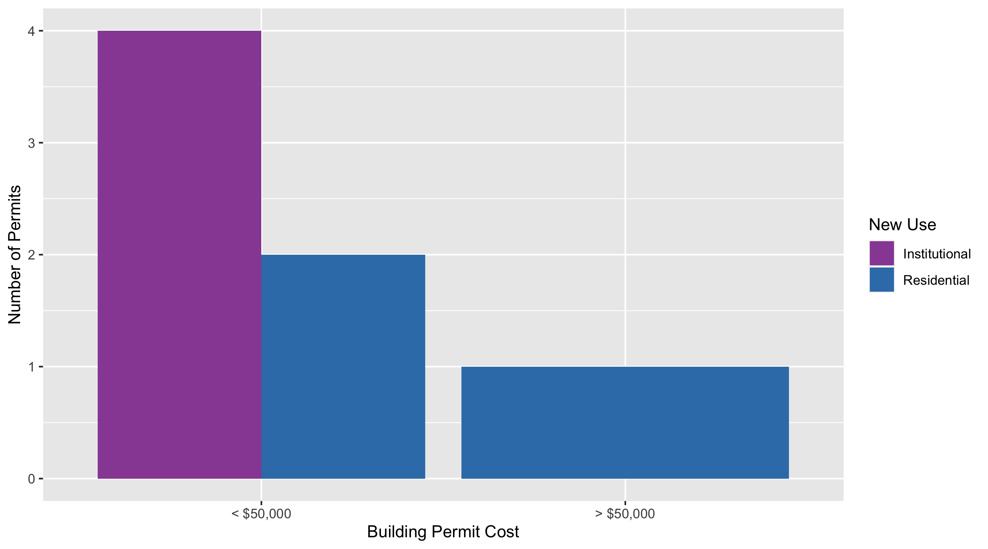
Cental West End Permit Cost Breakdown

Slide 17
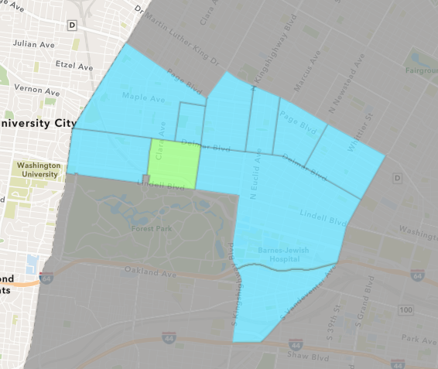
DeBaliviere Place
August 2020 Neighborhood Cost Breakdown
Mean: $0
Median: NA
Range: $0 - $0

Slide 18
DeBaliviere Place: Summary Notes
0 building permits in August 2020
-100.00% change compared to August 2019 (4 total building permits)
$0: Average building permit cost in August 2020
-100.00% change compared to August 2019 ($51,750)
30 total building permits in 2020
-18.92% change YTD compared to this time in 2019 (37 total building permits)
$730,584: YTD average building permit cost in 2020
1433.54% change YTD compared to this time in 2019 ($47,640)

Slide 19
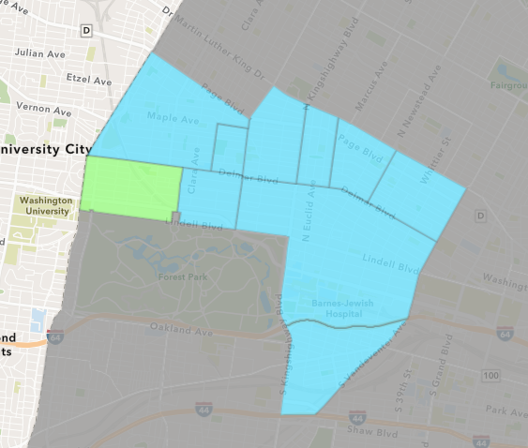
Skinker DeBaliviere
August 2020 Neighborhood Cost Breakdown
Mean: $850,000
Median: $850,000
Range: $200,000 - $1,500,000

Slide 20
Skinker DeBaliviere: Summary Notes
2 building permits in August 2020
-85.71% change compared to August 2019 (14 total building permits)
$850,000: Average building permit cost in August 2020
2395.66% change compared to August 2019 ($34,059)
82 total building permits in 2020
70.83% change YTD compared to this time in 2019 (48 total building permits)
$807,568: YTD average building permit cost in 2020
3802.32% change YTD compared to this time in 2019 ($20,695)

Slide 21
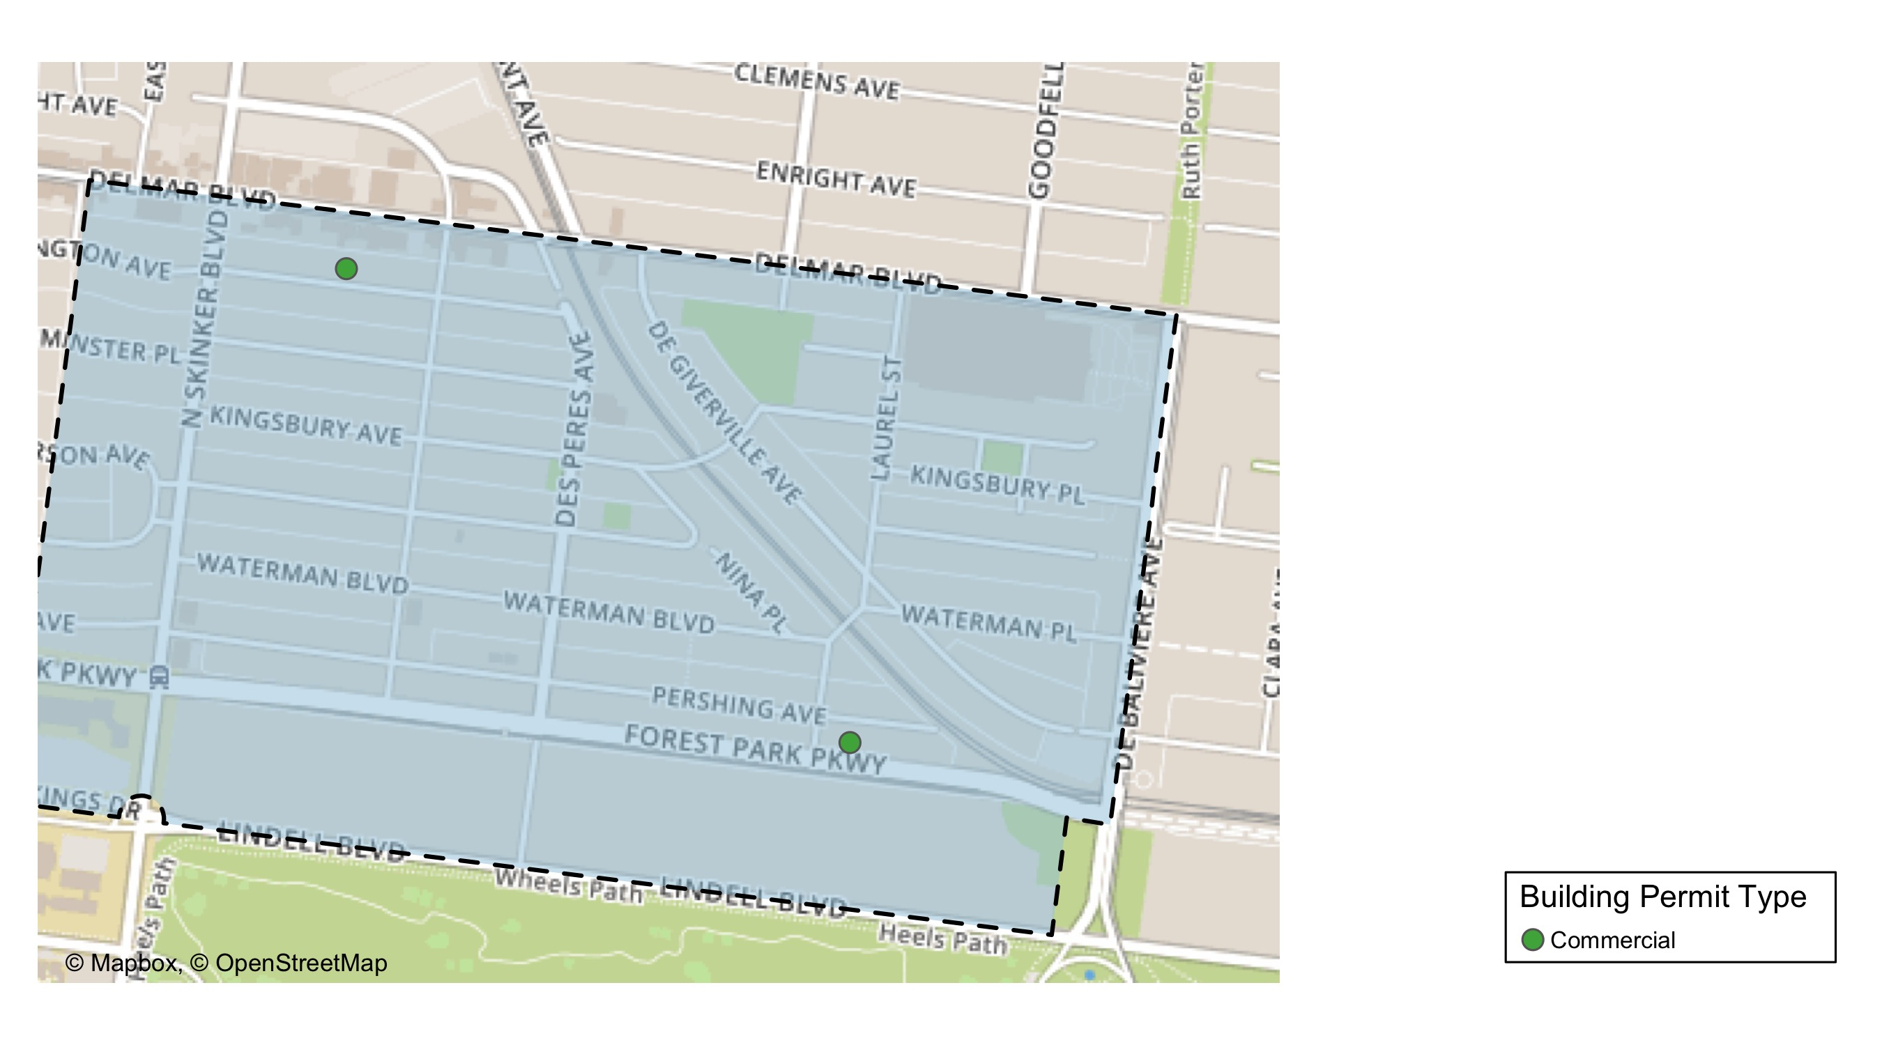
Skinker DeBaliviere

Slide 22
Skinker DeBaliviere
August 2020 | August 2020 | August 2020 | August 2020
Permit Use | Average Cost | # of Permits | Total Value of Permits
Commercial | $850,000 | 2 | $1,700,000
Industrial | $0 | 0 | $0
Institutional | $0 | 0 | $0
Residential | $0 | 0 | $0
Last 6 Months | Last 6 Months | Last 6 Months | Last 6 Months
Permit Use | Average Cost | # of Permits | Total Value of Permits
Commercial | $7,267,645 | 8 | $58,141,158
Industrial | $0 | 0 | $0
Institutional | $1,240,750 | 2 | $2,481,500
Residential | $110,765 | 46 | $5,095,197

Slide 23
Skinker DeBaliviere Individual Permit Breakdown
Owner | New Use | Cost | Address
BI-STATE DEVELOPMENT AGENCY | Commercial | $200,000 | 5720 DEGIVERVILLE AV
CHURCH BUILDING LLC | Commercial | $1,500,000 | 6166 DELMAR BLVD

Slide 24
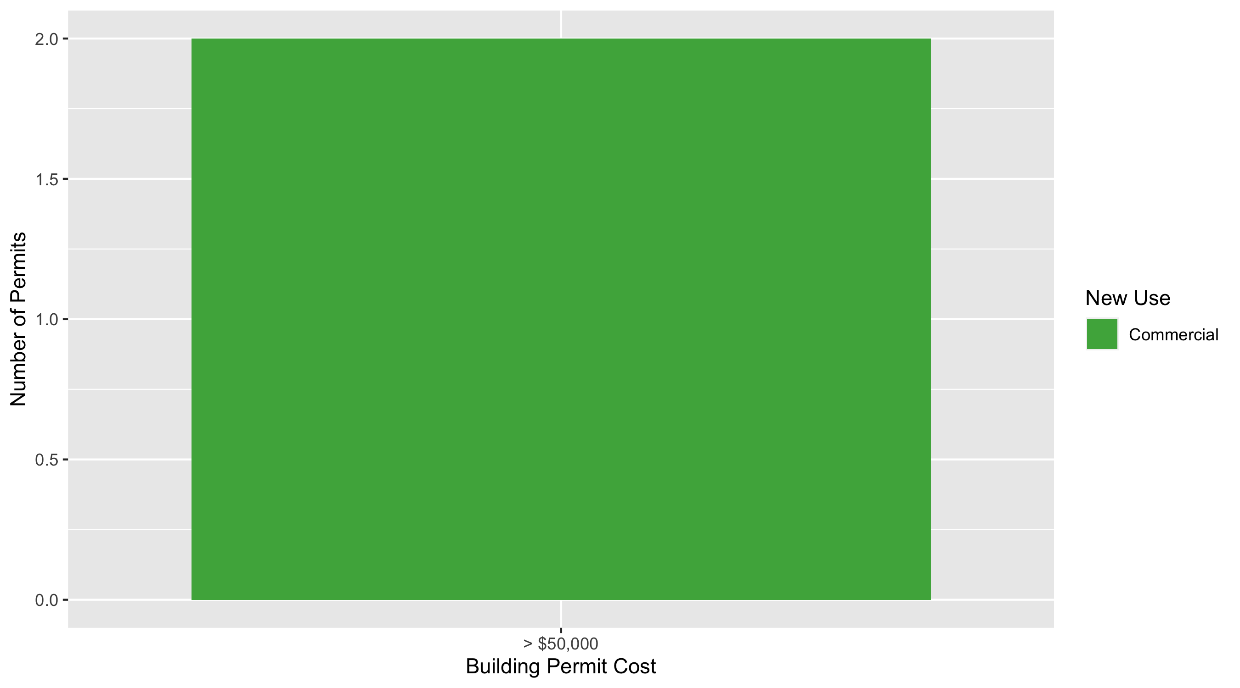
Skinker DeBaliviere Permit Cost Breakdown

Slide 25
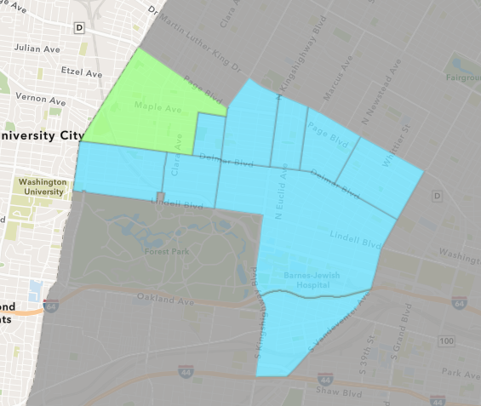
West End
August 2020 Neighborhood Cost Breakdown
Mean: $550,050
Median: $550,050
Range: $100,100 - $1,000,000

Slide 26
West End: Summary Notes
2 building permits in August 2020
-81.82% change compared to August 2019 (11 total building permits)
$550,050: Average building permit cost in August 2020
547.29% change compared to August 2019 ($84,977)
43 total building permits in 2020
34.38% change YTD compared to this time in 2019 (32 total building permits)
$541,085: YTD average building permit cost in 2020
248.77% change YTD compared to this time in 2019 ($155,143)

Slide 27
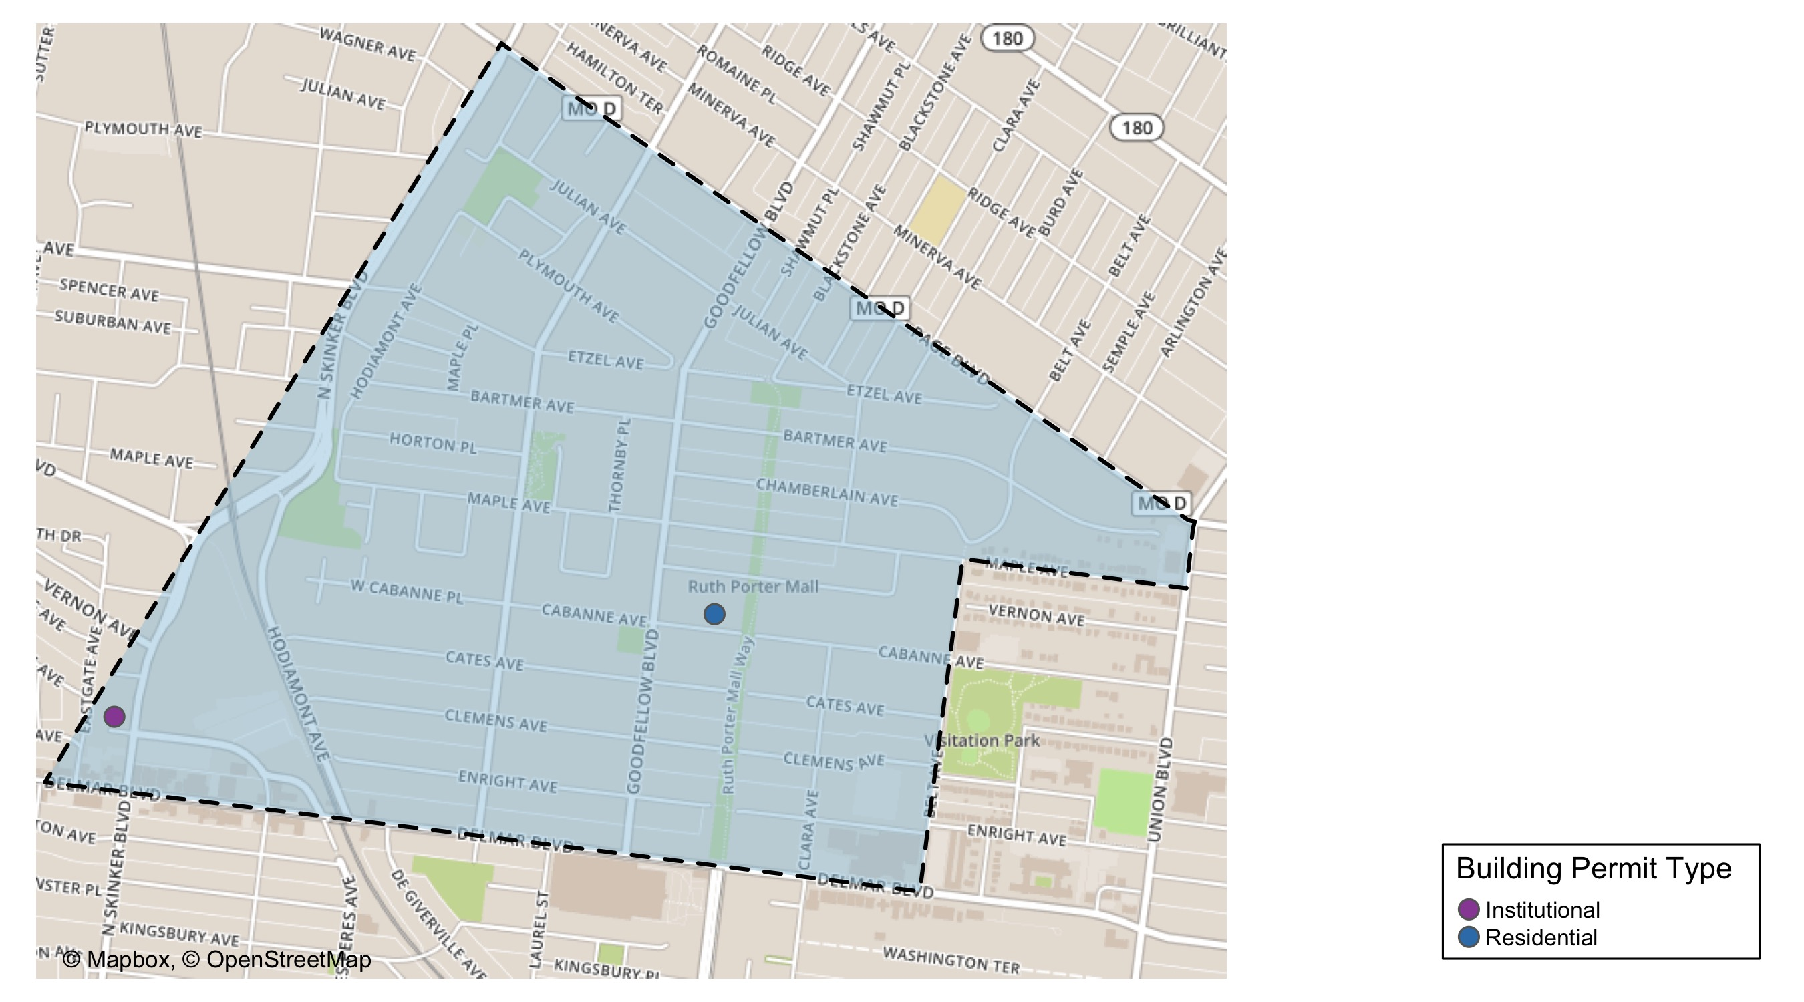
West End

Slide 28
West End
August 2020 | August 2020 | August 2020 | August 2020
Permit Use | Average Cost | # of Permits | Total Value of Permits
Commercial | $0 | 0 | $0
Industrial | $0 | 0 | $0
Institutional | $1,000,000 | 1 | $1,000,000
Residential | $100,100 | 1 | $100,100
Last 6 Months | Last 6 Months | Last 6 Months | Last 6 Months
Permit Use | Average Cost | # of Permits | Total Value of Permits
Commercial | $100,138 | 4 | $400,550
Industrial | $0 | 0 | $0
Institutional | $3,555,333 | 3 | $10,666,000
Residential | $621,761 | 19 | $11,813,450

Slide 29
West End Individual Permit Breakdown
Owner | New Use | Cost | Address
LRA | Residential | $100,100 | 5679 CABANNE AV
PACE-DELMAR ASSOCIATES LLC | Institutional | $1,000,000 | 621 N SKINKER BLVD

Slide 30
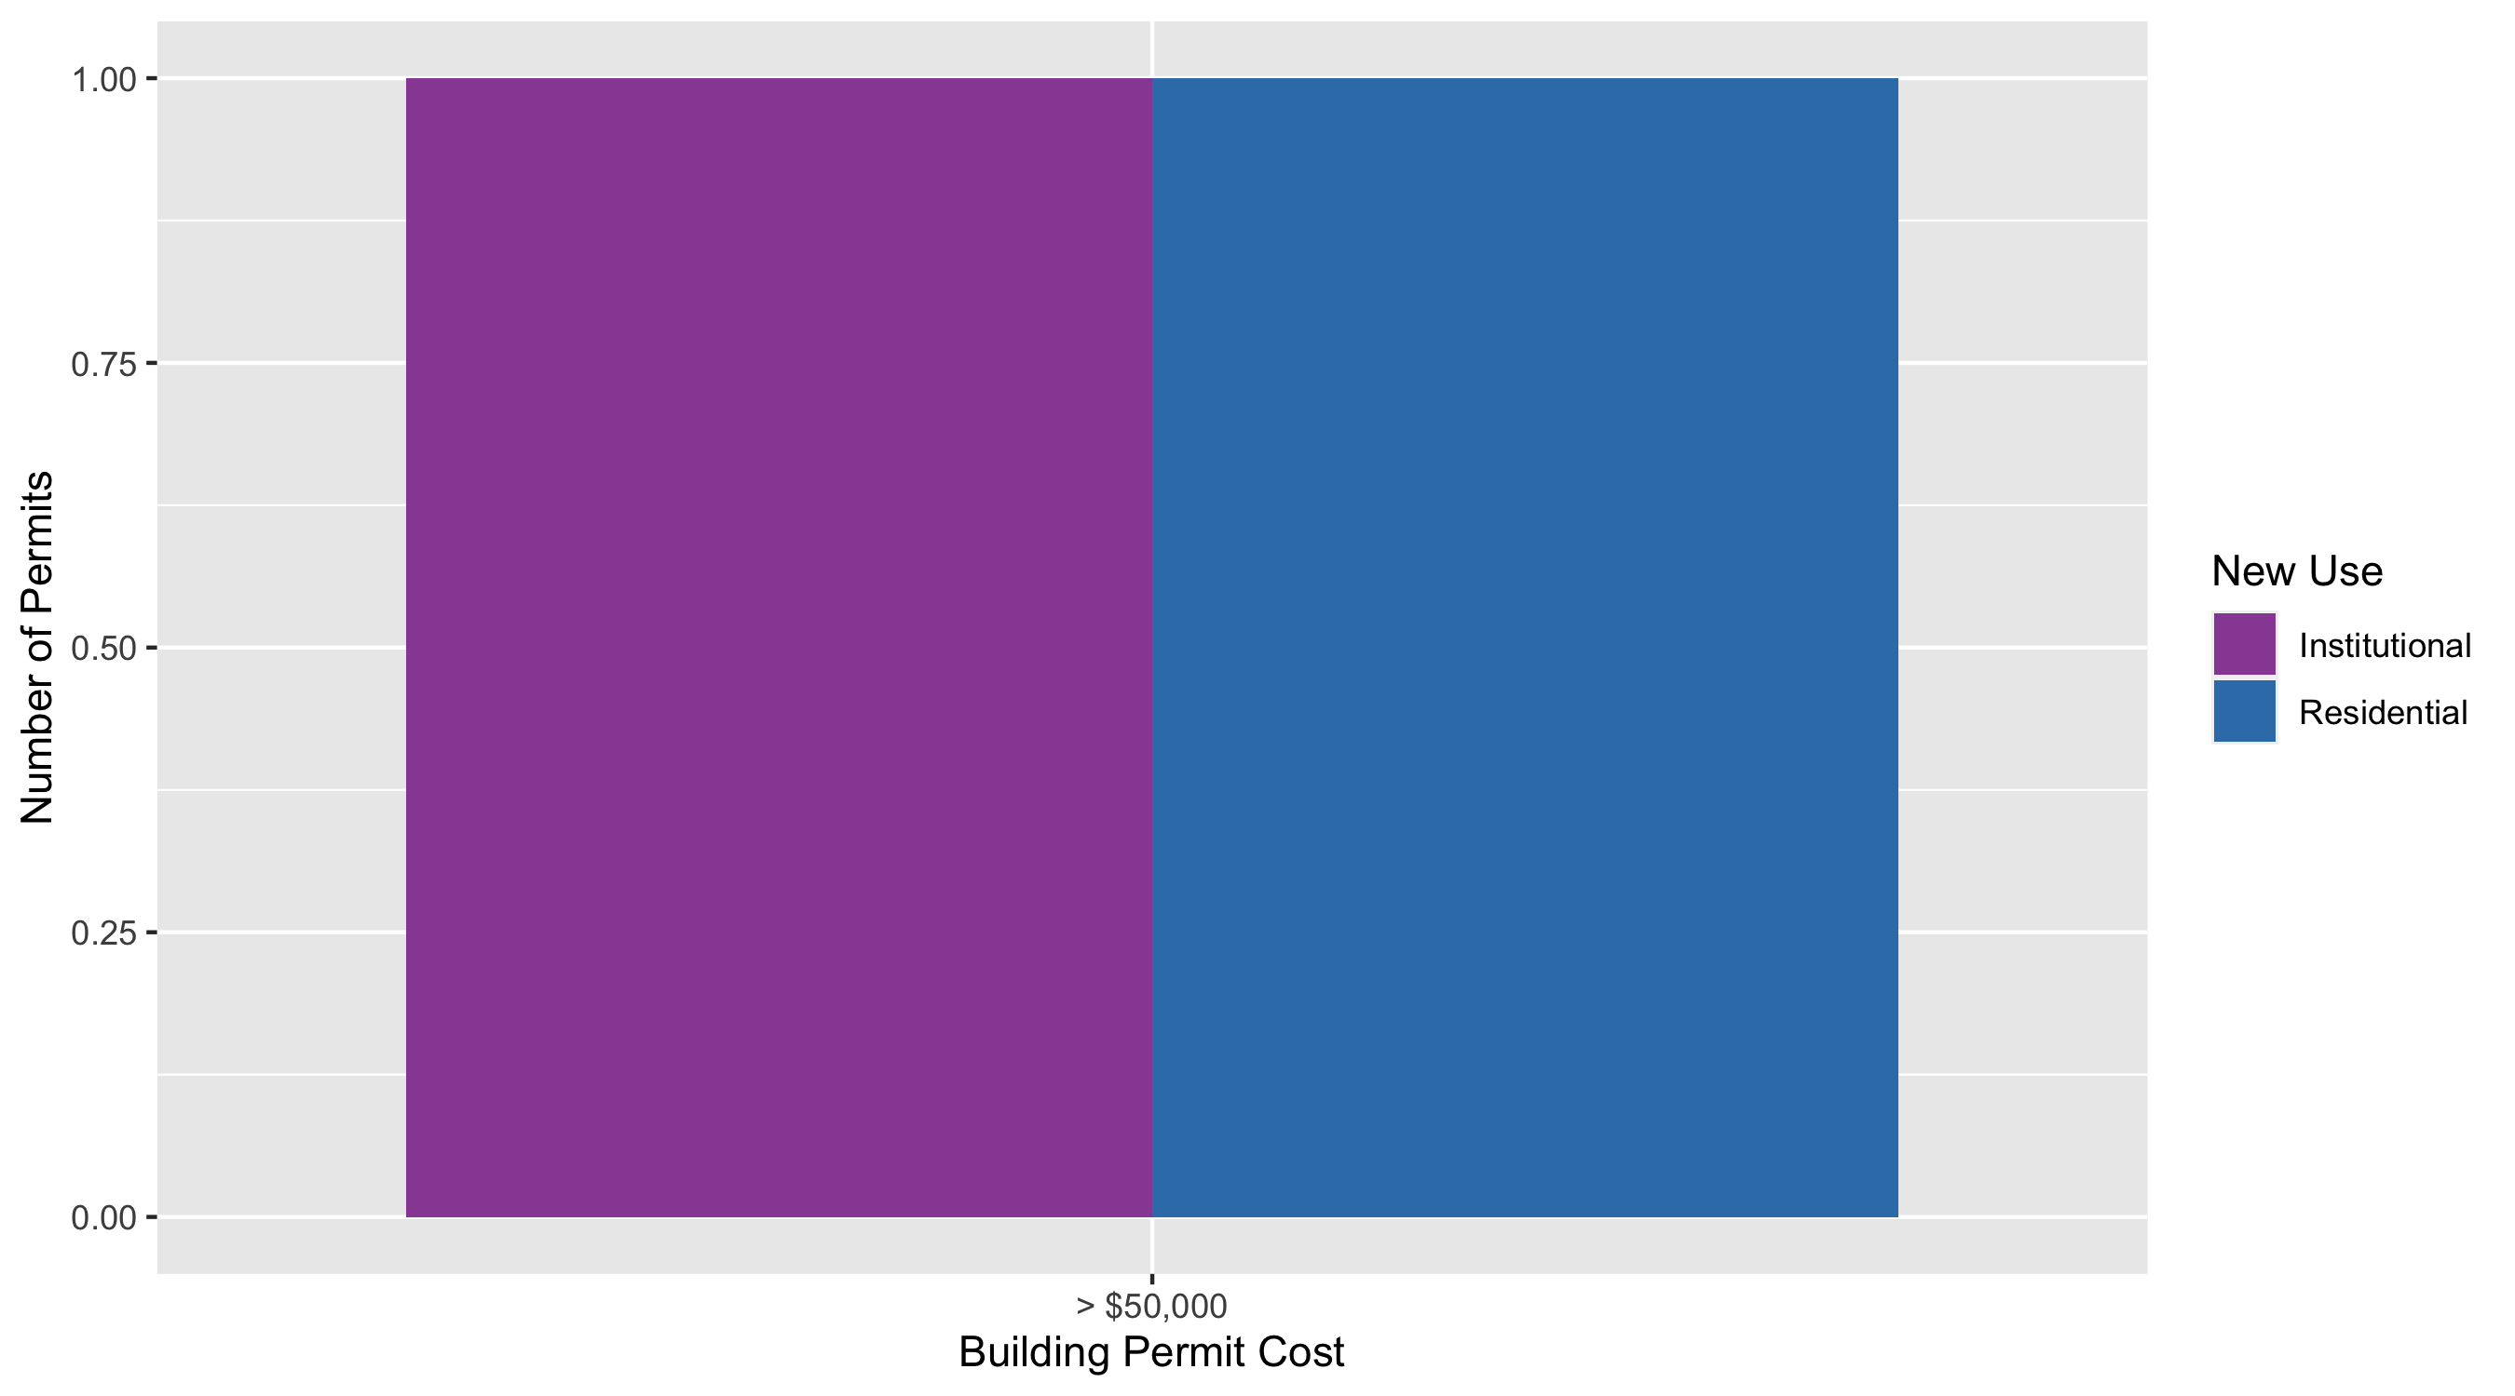
West End Permit Cost Breakdown

Slide 31
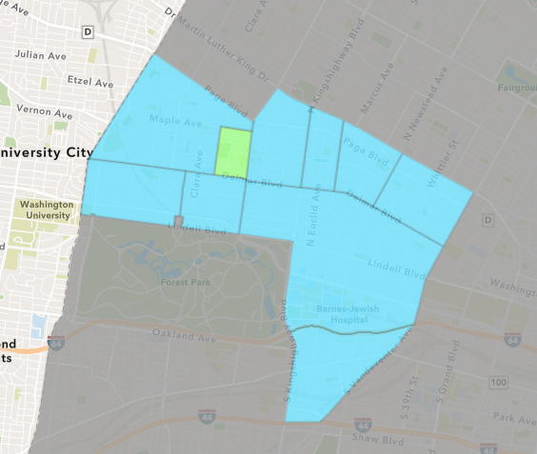
Visitation Park
August 2020 Neighborhood Cost Breakdown
Mean: $0
Median: NA
Range: $0 - $0

Slide 32
Visitation Park: Summary Notes
0 building permits in August 2020
-100.00% change compared to August 2019 (1 total building permits)
$0: Average building permit cost in August 2020
-100.00% change compared to August 2019 ($8,000)
4 total building permits in 2020
300.00% change YTD compared to this time in 2019 (1 total building permits)
$9,378: YTD average building permit cost in 2020
17.22% change YTD compared to this time in 2019 ($8,000)

Slide 33
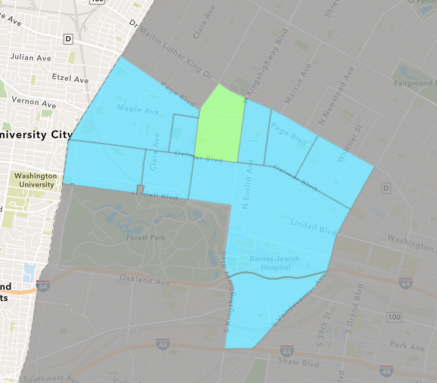
Academy
August 2020 Neighborhood Cost Breakdown
Mean: $0
Median: NA
Range: $0 - $0

Slide 34
Academy: Summary Notes
0 building permits in August 2020
-100.00% change compared to August 2019 (3 total building permits)
$0: Average building permit cost in August 2020
-100.00% change compared to August 2019 ($100,833)
28 total building permits in 2020
27.27% change YTD compared to this time in 2019 (22 total building permits)
$48,552: YTD average building permit cost in 2020
-36.22% change YTD compared to this time in 2019 ($76,123)

Slide 35
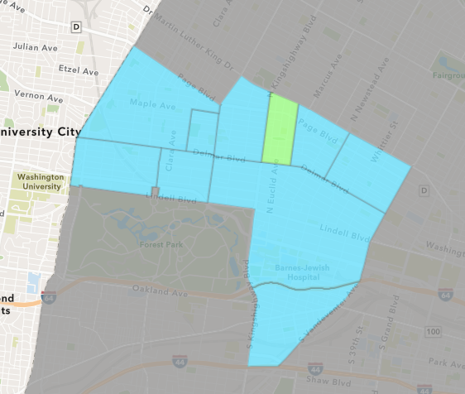
Fountain Park
August 2020 Neighborhood Cost Breakdown
Mean: $0
Median: NA
Range: $0 - $0

Slide 36
Fountain Park: Summary Notes
0 building permits in August 2020
-100.00% change compared to August 2019 (2 total building permits)
$0: Average building permit cost in August 2020
-100.00% change compared to August 2019 ($1,832)
7 total building permits in 2020
0.00% change YTD compared to this time in 2019 (7 total building permits)
$58,357: YTD average building permit cost in 2020
72.24% change YTD compared to this time in 2019 ($33,881)

Slide 37
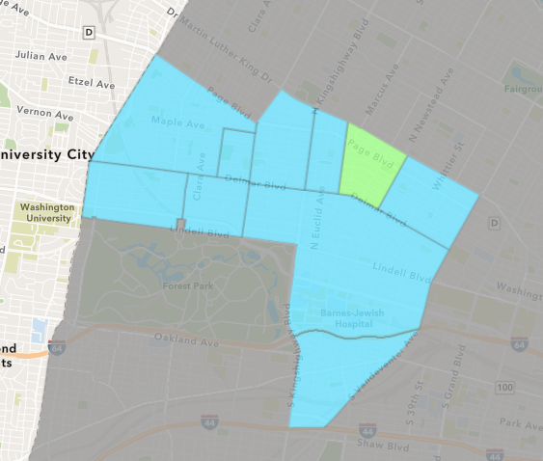
Lewis Place
August 2020 Neighborhood Cost Breakdown
Mean: $0
Median: NA
Range: $0 - $0

Slide 38
Lewis Place: Summary Notes
0 building permits in August 2020
0.00% change compared to August 2019 (0 total building permits)
$0: Average building permit cost in August 2020
0.00% change compared to August 2019 ($0)
6 total building permits in 2020
0.00% change YTD compared to this time in 2019 (6 total building permits)
$72,700: YTD average building permit cost in 2020
961.31% change YTD compared to this time in 2019 ($6,850)

Slide 39
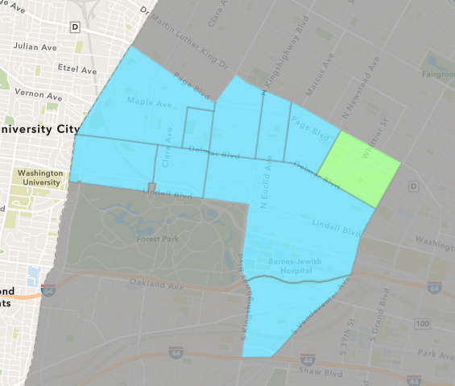
Vandeventer
August 2020 Neighborhood Cost Breakdown
Mean: $0
Median: NA
Range: $0 - $0

Slide 40
Vandeventer: Summary Notes
0 building permits in August 2020
-100.00% change compared to August 2019 (3 total building permits)
$0: Average building permit cost in August 2020
-100.00% change compared to August 2019 ($97,667)
8 total building permits in 2020
-68.00% change YTD compared to this time in 2019 (25 total building permits)
$48,135: YTD average building permit cost in 2020
-64.07% change YTD compared to this time in 2019 ($133,962)

Slide 41
Additional Notes
Data retreived from https://www.stlouis-mo.gov/data/
Building permits with a cost of $0 were dropped
Building permits that were cancelled were dropped
Infinite change indicates 0 permits in the current or previous time period/comparison month so there was a overall increase or decrease

